Slide 1



DEPARTMENT OF COMPUTER SCIENCE & ENGINEERING IN ARTIFICIAL INTELLIGENCE AND MACHINE LEARNING
PRESENTATION
ON
TOPIC NAME: FACEFIT ADVISOR AI STYLE AND
ACCESSORIES SUGGESTIONS
PRESENTED BY:
55.SHRUTI PENDNEKAR 62.CHITRANG SAWANT
63.LABH SAWANT 66.SNEHA SHINDE
GUIDED BY:
PROF. AMITA RAMAN

Slide 2

OUTLINE OF PRESENTATION
⮚INTRODUCTION
⮚LITERATURE SURVEY
⮚MOTIVATION AND CHALLENGES
⮚PROBLEM STATEMENT
⮚ALGORITHM
⮚BLOCK DIAGRAM
⮚CONCLUSION
⮚REFERENCES

Slide 3
INTRODUCTION
In today’s world of personalization, people want customized fashion and style advice that truly suits them. However, figuring out which styles match someone’s features—especially their face shape—can be difficult. The “FaceFit” project was created to make this process easier and more objective.
Its main goal is to build an AI-based application that analyzes a person’s face and offers science-backed styling suggestions. By combining advanced AI tools like OpenCV for image processing, Dlib for facial detection, Scikit-learn for model development, and the Google Gemini API for generating descriptions, FaceFit connects complex facial analysis with simple, practical fashion advice. This report explains the full development process, from data collection and model training to final deployment.

Slide 4
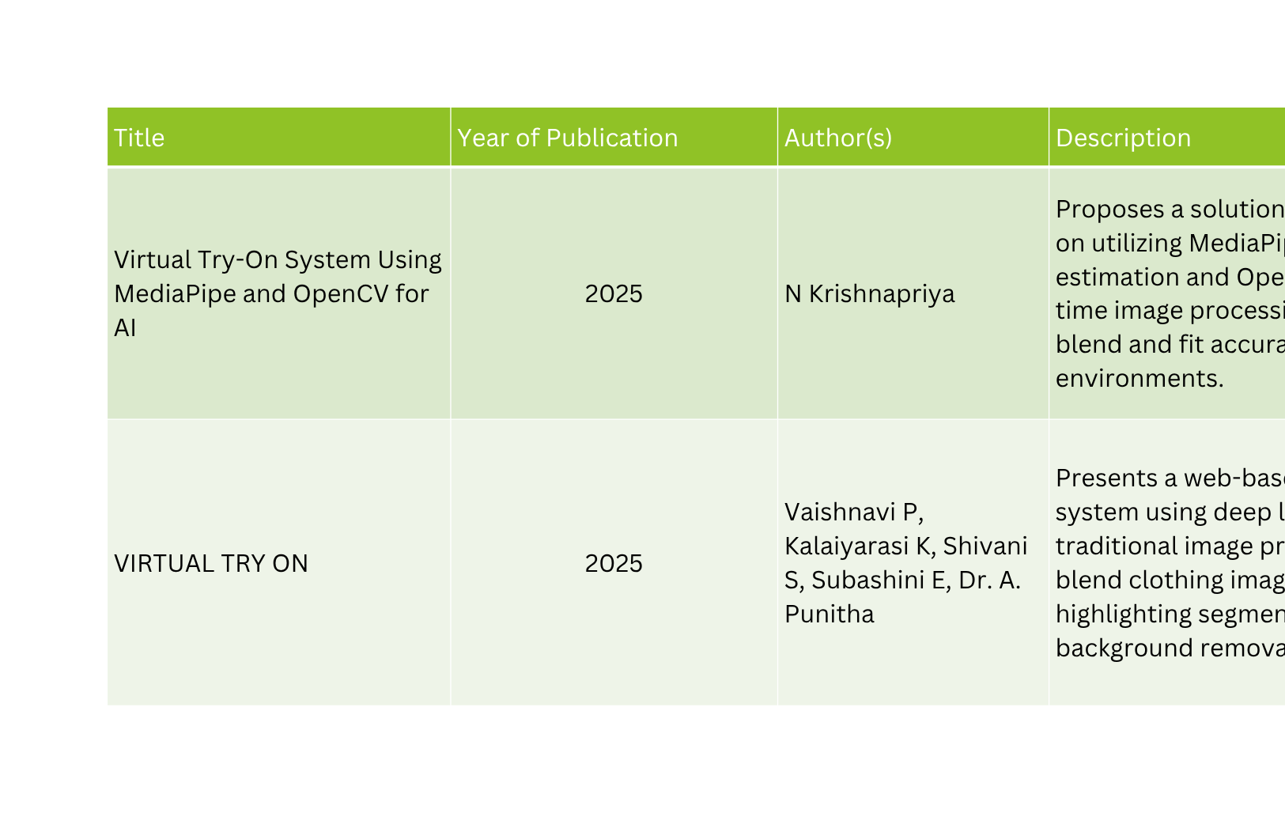
LITERATURE SURVEY

Slide 5
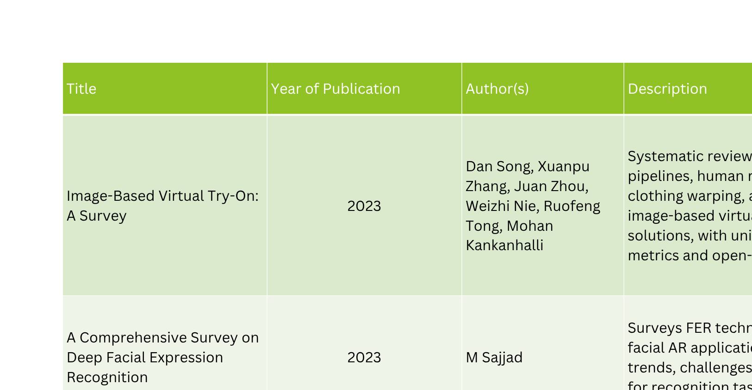
LITERATURE SURVEY

Slide 6
MOTIVATION & CHALLENGES
Motivation:
  Enable users to virtually try diverse fashion accessories in real time without physical products.
  Innovate in domains like online shopping, personal styling, and interactive entertainment by blending AI and visual effects.
Challenges:
  Accurate facial landmark detection in varying lighting, poses, and facial expressions.
  Dynamic accessory retrieval from external APIs and handling rate limits, image variability, and caching.
  Seamless blending of accessories with alpha transparency to create realistic appearances.
  Managing multiple faces in a video stream while maintaining performance and accuracy.

Slide 7
PROBLEM STATEMENT
To addresses the issues of subjectivity, inconvenience, and lack of personalization in accessory selection. Traditionally, people rely on trial-and-error, mirrors, or others’ opinions, leading to dissatisfaction and poor choices. In stores, trying multiple items is time-consuming and raises hygiene concerns, while online shopping without virtual try-ons increases return rates.
The goal is to develop a fast, reliable tool that accurately analyzes face shapes and provides instant virtual fitting—enhancing user confidence, improving shopping experiences, and supporting scalable retail solutions.

Slide 8
ALGORITHM
Step 1: START / INITIALIZE MODELS
Action: Begin the application and load necessary resources.
Description: Initialize the face detector, 68-landmark predictor, and the trained Machine Learning (ML) model for face shape classification.
Step 2: INPUT FRAME
Action: Capture the next frame of data.
Description: Input a new image frame from the webcam or a static image file
Step 3: DECISION: DETECT FACE?
Action: Run the face detection model.
Description: Check if one or more human faces are present in the current frame. If YES, proceed to
Step 4. If NO, skip to Step 10.
Step 4: FIND 68 FACIAL LANDMARKS
Action: Locate 68 distinct points on the detected face.
Description: Use the landmark predictor model to map the key geometric points of the face.
Next Step: Simultaneously proceed to Step 5 (Classification Path) and Step 7 (Augmentation Path).
Classification Path (Face Shape)

Slide 9
ALGORITHM
Step 4: FIND 68 FACIAL LANDMARKS
Action: Locate 68 distinct points on the detected face.
Description: Use the landmark predictor model to map the key geometric points of the face.
Next Step: Simultaneously proceed to Step 5 (Classification Path) and Step 7 (Augmentation Path).
Classification Path (Face Shape)
Step 5: EXTRACT GEOMETRIC FEATURES (RATIOS)
Action: Calculate facial measurements.
Description: Use the 68 landmarks to compute specific distance ratios (e.g., width-to-length ratios) that define the face shape.
Step 6: ML MODEL: CLASSIFY FACE SHAPE
Action: Run the classification model.
Description: Input the geometric features into the trained ML model to output the face shape result (e.g., 'Oval', 'Square').
Step 7: DISPLAY FACE SHAPE & SUGGESTIONS
Action: Prepare face shape output for the user.
Description: Generate text/graphics displaying the classified face shape and tailored style suggestions.
Next Step (Merge): Go to Step 12. Augmentation Path (Accessory Overlay)

Slide 10
ALGORITHM
Step 7: DISPLAY FACE SHAPE & SUGGESTIONS
Action: Prepare face shape output for the user.
Description: Generate text/graphics displaying the classified face shape and tailored style suggestions.
Next Step (Merge): Go to Step 12. Augmentation Path (Accessory Overlay)
Step 8: CALCULATE HEAD POSE ANGLE & SCALE
Action: Determine 3D orientation and size.
Description: Use the landmarks to calculate the head's rotation (pitch, yaw, roll) and scale relative to the camera.
Step 9: APPLY ROTATION & SCALING TO ACCESSORY IMAGE
Action: Transform the accessory graphic.
Description: Adjust the virtual accessory (e.g., sunglasses, hat) to match the calculated head pose and scale.

Slide 11
ALGORITHM
Step 10: OVERLAY ACCESSORY ONTO FACE USING ALPHA BLENDING
Action: Merge the accessory and the frame.
Description: Combine the transformed accessory with the original input frame, using alpha blending for realistic transparency and integration.
Next Step (Merge): Go to Step 12. Error Handling and Loop
Step 11: NO FACE DETECTED
Action: Skip processing.
Description: No landmarks or calculations are performed. The original frame (or a 'No Face' message) is maintained.
Next Step (Merge): Go to Step 12.
Step 12: DISPLAY AUGMENTED FRAME TO USER
Action: Present the final output.
Description: Display the processed image to the user. This frame includes the augmented accessory overlay (if applicable) and the face shape information/suggestions.

Slide 12
ALGORITHM
Step 13: DECISION: USER QUITS LOOP?
Action: Check for user termination.
Description: Continuously check for a user input (e.g., clicking a 'Stop' button). If NO (Continue), go back to Step 2. If YES (Stop), go to Step 14.
Step 14: STOP APPLICATION
Action: Gracefully shut down.
Description: De-initialize the webcam feed and models, then terminate the application.

Slide 13
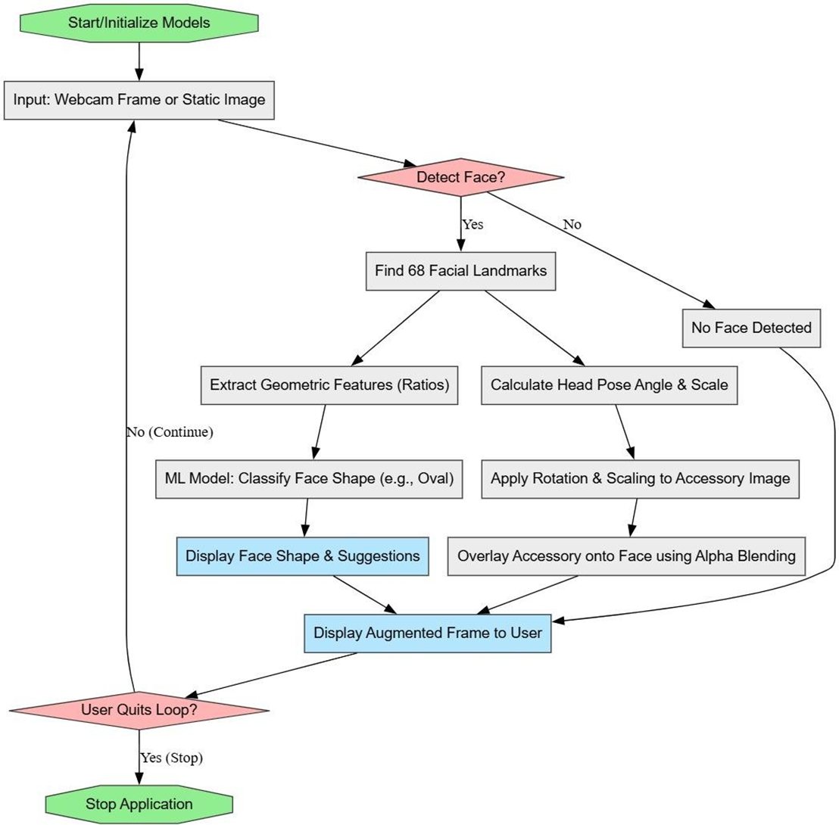
FLOWCHART

Slide 14
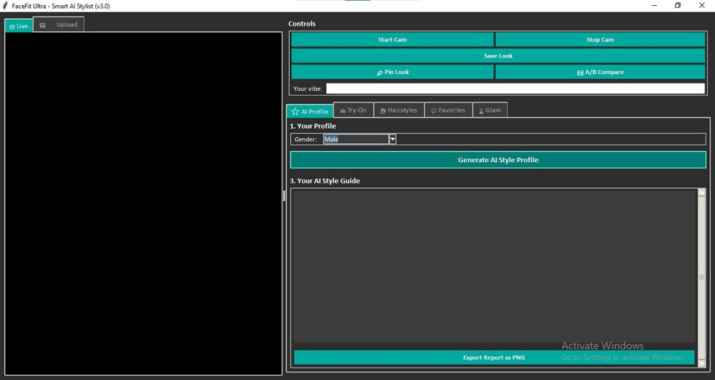
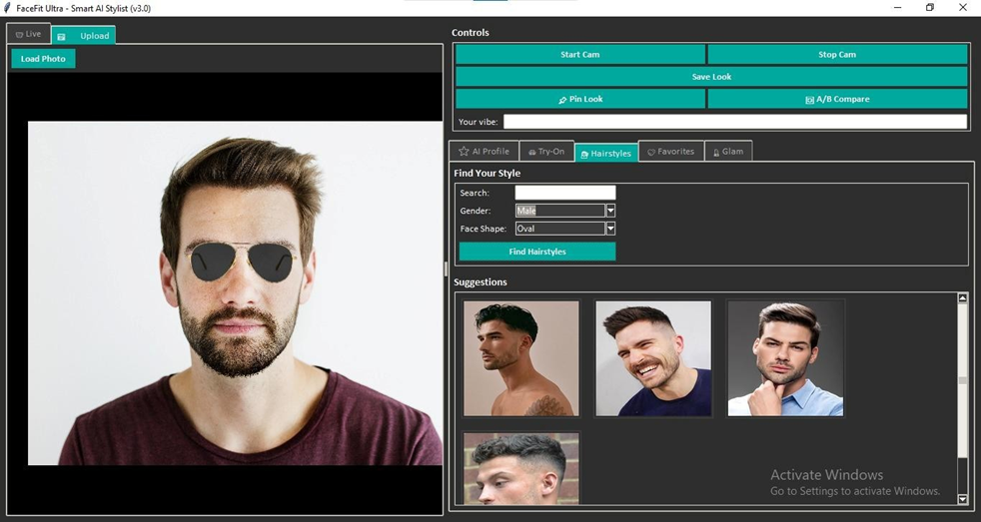
PROJECT OUTPUT
Fig no 01:-This image is a screenshot of the FaceFit Ultra AI Stylist software's "AI Profile" homepage in an initial state.
Fig no 02:-This image is a screenshot of the FaceFit Ultra AI Stylist software's "Hairstyles" recommendation feature.

Slide 15
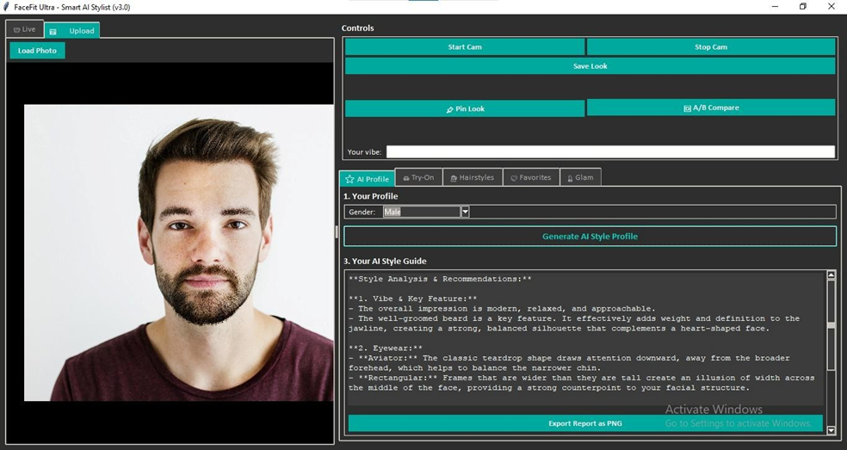
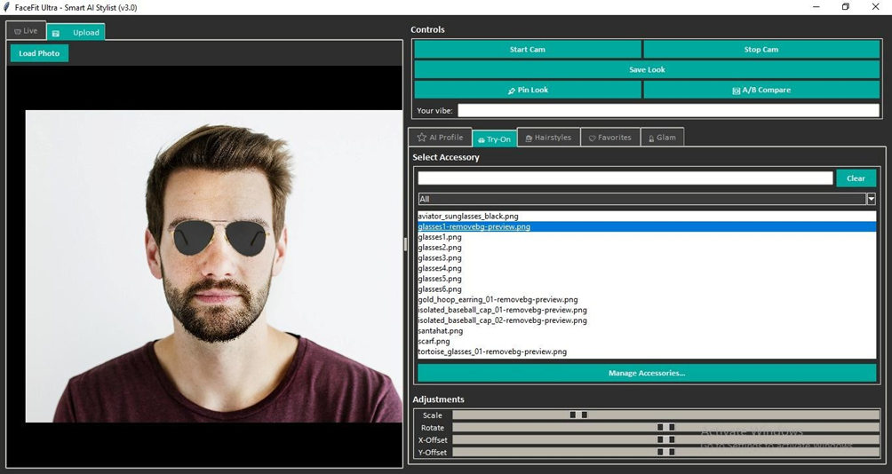
PROJECT OUTPUT
Fig no 03:-This image displays the output of the FaceFit Ultra AI Stylist software, showing a male model's photo alongside its AI Style Guide.
Fig no 04:-This image is a screenshot of the FaceFit Ultra AI Stylist software's "Try-On" feature

Slide 16
CONCLUSION
The FaceFit project successfully achieved its objective of creating an intelligent personal stylist. By combining computer vision and machine learning, it provides a data-driven approach to style recommendations, moving beyond generic advice to offer personalized guidance.
There are several avenues for future enhancement:
  · Expanded Feature Set: Incorporating analysis of other features like skin tone, eye color, and hair type to provide even more comprehensive recommendations (e.g., makeup, clothing colors).
  · Advanced Recommendation Models: Implementing a more sophisticated recommendation engine, perhaps using collaborative filtering or deep learning models trained on fashion datasets.
  · Real-time Video Analysis: Modifying the application to work with a live video feed, providing real-time feedback and virtual try-on features for different hairstyles or glasses.
  · Mobile Application: Developing a mobile version of FaceFit to make the tool more accessible to a wider audience.

Slide 17
REFERENCES
  Viola, P. and Jones, M. (2001). Rapid object detection using a boosted cascade of simple features. Computer Vision and Pattern Recognition, 2001. CVPR 2001.
  Kazemi, V., & Sullivan, J. (2014). One millisecond face alignment with an ensemble of regression trees. IEEE Conference on Computer Vision and Pattern Recognition (CVPR). (The basis for Dlib's shape predictor).
  Bradski, G. (2000). The OpenCV Library. Dr. Dobb's Journal of Software Tools.
  Standard Face Shape Classification Methods and Geometric Feature Extraction Techniques in Biometrics.
  Python Libraries: Dlib Documentation, OpenCV Documentation, Scikit-learn Documentation, Tkinter Reference.
  https://www.youtube.com/watch?v=swSp8ksR2Q
  https://www.youtube.com/watch?v=VjDsJ2piXg8
  https://www.youtube.com/watch?v=azvA2Bn2aXw
  https://www.youtube.com/watch?v=C94pTaKoLbU

